Slide 1

PowerShell Debugging
Debugging with PowerShell Tools / IDE’s

Slide 2
What We Will Cover
Error Types
Emitting Diagnostic Data
Using Breakpoints
Variable Breakpoints
Debugging in ISE
Debugging in VSCODE
Debugging in the console

Slide 3

Error Types
Syntax Errors
Wrong “Grammar”, unbalanced Quotes, etc.
Parser will reject code, code never runs
Runtime Errors
Legal code throwing errors when running
“Drive letter already taken”, “Access denied”, etc.
Subject to error handling
Logical Errors
All runs fine – no errors
Code just does not produce the desired results
Notes:
C:\Users\crshn\onedrive\debug
.\1 bugs.ps1
Syntax errors:
Runtime errors:
Logical errors: errors in which the logic performs as expected however it does not meet the business requirements.

Slide 4
Emitting Diagnostic Information
Write-Debug statements
No output in production scripts
[CmdletBinding()]
$DebugPreference = 'Continue' to enable output
-Debug common parameter turns Write-Debug into simple BPs(BreakPoints)
Use global: diagnostic variables
Store variable content in global variable, inspect later
Notes:
.
'.\2 emit diagnostic data.ps1' -Debug
Show how you can add cmdlet binding and allow for debugging in your script
https://blogs.technet.microsoft.com/poshchap/2014/10/24/scripting-tips-and-tricks-cmdletbinding/
Debug preference: help about_Preference_Variables –showwindow
To
<#
Either call the script with the common parameter -Debug
Or set $DebugPreference to the desired debugging mode:
$DebugPreference = 'Continue' # show debug messages but do not stop
$DebugPreference = 'Stop' # immediately abort after first message (nonsense here)
$DebugPreference = 'Inquire' # ask what to do (this is default for -Debug)
$DebugPreference = 'SilentlyContinue' # hide messages (default)
#>
Error handling:
https://blogs.msdn.microsoft.com/kebab/2013/06/09/an-introduction-to-error-handling-in-powershell/

Slide 5
Using Breakpoints
Requires a running script (no Untitled documents)
Break into live code (PS5) – with powershell.exe
Wait-Debugger or CTRL+B
Get-Command –Noun PSBreakpoint
Line Breakpoint
Requires a saved script
Halts when executable code reaches the line
Command Breakpoint
Halts when command/function is executed
Variable Breakpoint
Halts when variable content is read or changed
Action
None: always breaks
Scriptblock: executes code, can optionally break with "break"
Notes:
PS C:\Users\crshn\onedrive\debug> help *breakpoint*
Name Category Module Synopsis
---- -------- ------ --------
Disable-PSBreakpoint Cmdlet Microsoft.PowerShell.U... Disables the breakpoints in the current console.
Enable-PSBreakpoint Cmdlet Microsoft.PowerShell.U... Enables the breakpoints in the current console.
Get-PSBreakpoint Cmdlet Microsoft.PowerShell.U... Gets the breakpoints that are set in the curre...
Remove-PSBreakpoint Cmdlet Microsoft.PowerShell.U... Deletes breakpoints from the current console.
Set-PSBreakpoint Cmdlet Microsoft.PowerShell.U... Sets a breakpoint on a line, command, or varia...
Wait-Debugger – a cmdlet that will wait for debugger.
Stops a script in the debugger before running the next statement in the script

Slide 6
Variable Breakpoints
Modes
Read, Write, ReadWrite
Best Practice:
bind to a script! - PS uses lots of variables internally
Conditional Breakpoints
Provide Action scriptblock to breakpoint
Call "Break" yourself when appropriate
Notes:
Action – this is to take action when hitting the breakpoint
Column – this is the column that you want to break on and must include a script name and a line number.
Command – this is the command or function to stop on
Line – this is the line number to stop on requires you to be working on a script

Slide 7
Debugging in ISE
Setting a breakpoint
Must have a saved file
Set Breakpoints before running the script
F9 toggles line breakpoints

Slide 8
Debugging in VSCODE
Two different types of configurations.
Launch – launch a script with vscode and execute
Attach - attach to an already running script
Anatomy of the launch .json
"configurations": [
{
"type": "PowerShell",
"request": "launch",
"name": "PowerShell Launch Current File",
"script": "${file}",
"args": [],
"cwd": "${file}"
},
Json configuration
Launch in current session
Using our current file
No arguments
Notes:
https://code.visualstudio.com/docs/editor/debugging#_launch-configurations
https://blogs.msdn.microsoft.com/brian_farnhill/2017/09/27/using-the-launch-json-file-in-vs-code-for-improved-powershell-debugging/

Slide 9
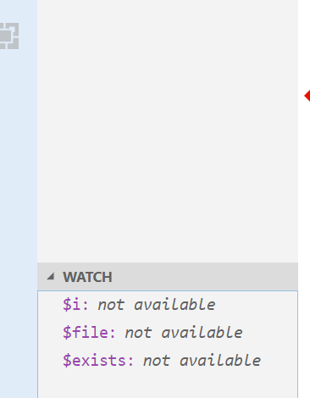
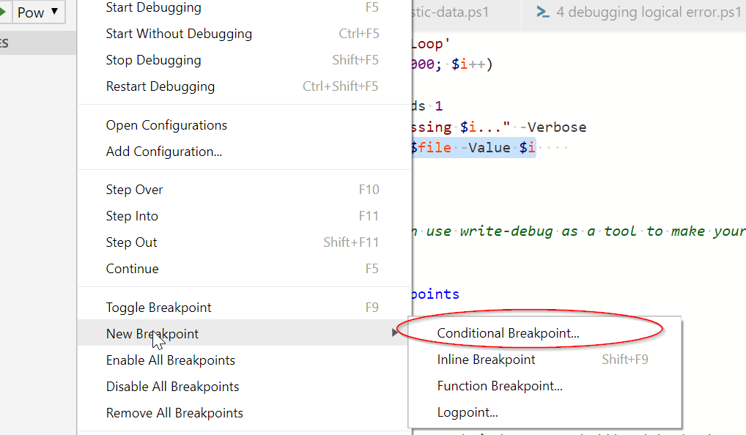
Debugging in VSCODE continued
Can add a Watch to see the contents of a variable change
Variable breakpoint
Use the Conditional breakpoint

Slide 10
Debugging in the console
Get-Psbreakpoint
Variable breakpoint (no $)
Script breakpoint
Column – set a breakpoint at a specific column in the script
Used with line
Line - set a breakpoint at one or many lines
Requires a script value

Slide 11
How to Contact Me
Website: http://powershellposse.com
E-Mail: crshnbrn66@gmail.com
Twitter: driberif

Slide 12
Runspace Debugging
Runspace
Thread that executes a PowerShell host
Multiple Runspaces per Process possible
Previous examples targeted local runspace
Debugging another runspace
Debug-Runspace –id X
Accessing Runspaces in another process
Enter-PSHostProcess

Slide 13
Debugging Remote Sessions
Remote Session
Separate powershell.exe called wsmprovhost.exe
Accessible via WinRM / Remoting
Psedit does heavy lifting
Enter-PSSession, then load local script using psedit
Alternative
Enter remote session, set breakpoints, then run
Or, use Wait-Debugger inside code to stop at given location

